Slide 2
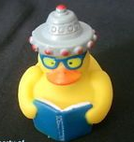
We Didn’t Start the Fire
http://fire2014.weebly.com
Sparking a shift in student learning

Slide 3
Learning Targets
I will collaborate within my group to create an argument that will impact student learning.
I will active my prior knowledge by completing a K-W-L to launch an argumentative position.
I will be a student for the next hour; learning from those around me.
I will become intimate with the one I love (Embrace it or else).
I will feed my wild side (in a “sweet way”)

Slide 4
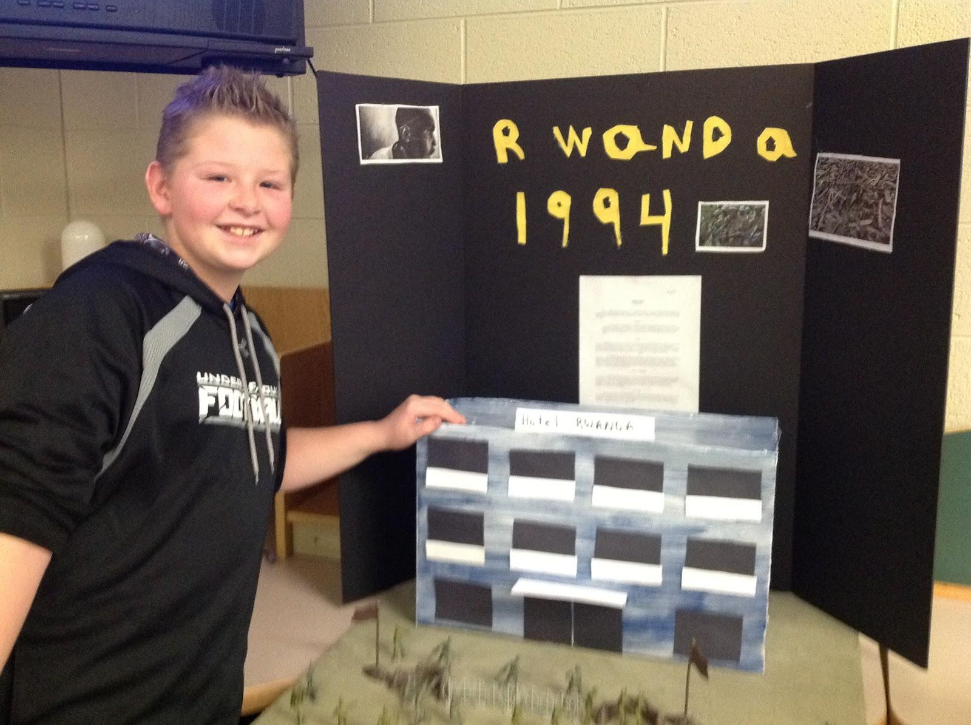
Generating a Topic
Role as a Teacher
Activate Prior Knowledge
Channel One Issues
Process (Modeled for Students)
African Studies

Slide 5
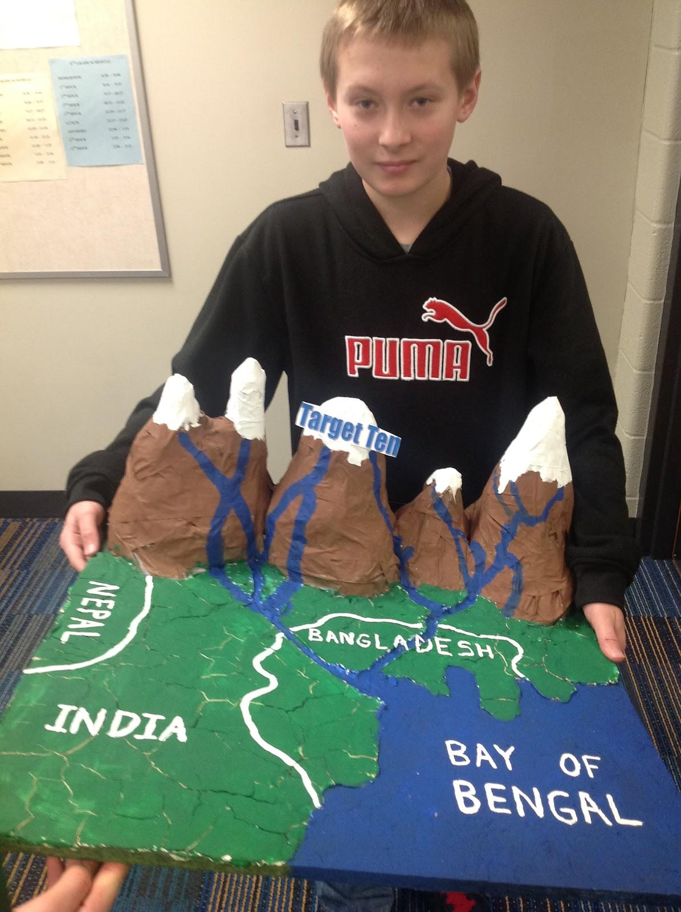
Creating Content
Resource
Collaborating on a shared document (Google Drive)
K & W
K = Metacognition (Think about your thinking)
W= Create Questions / Targeting my idea
Choose a Focus/Essential Question
Wikisummarizer your idea
Gathering of data/research/facts (Think like a Detective!)
Based on evidence, what is your essential question?

Slide 6
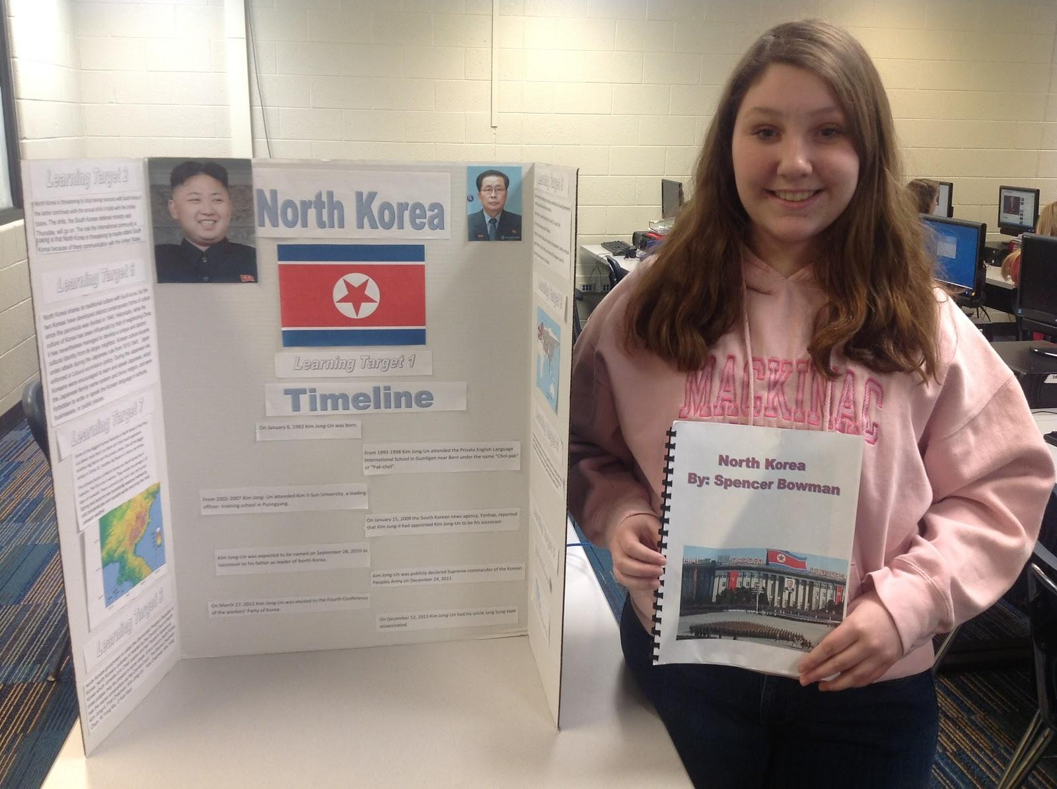

Slide 7
Creating Content
Resource
Collaborating on a shared document (Google Drive)
K & W
K = Metacognition (Think about your thinking)
W= Create Questions / Targeting my idea
Choose a Focus/Essential Question
Wikisummarizer your idea
Gathering of data/research/facts (Think like a Detective!)
Based on evidence, what is your essential question?

Slide 8
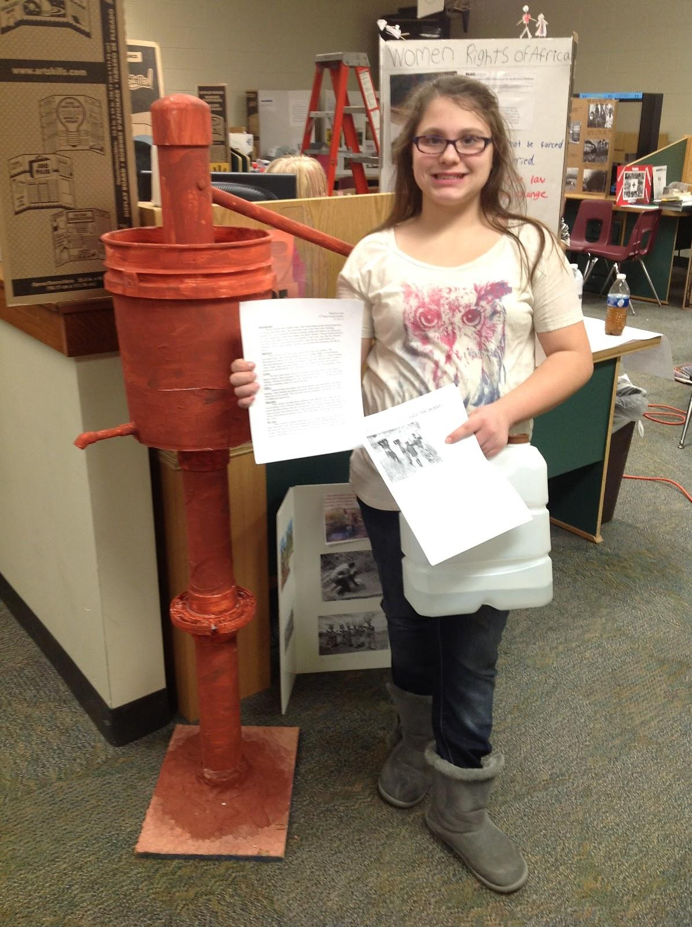

Slide 9
Creating Content
Resource
Collaborating on a shared document (Google Drive)
K & W
K = Metacognition (Think about your thinking)
W= Create Questions / Targeting my idea
Choose a Focus/Essential Question
Wikisummarizer your idea
Gathering of data/research/facts (Think like a Detective!)
Based on evidence, what is your essential question?

Slide 10
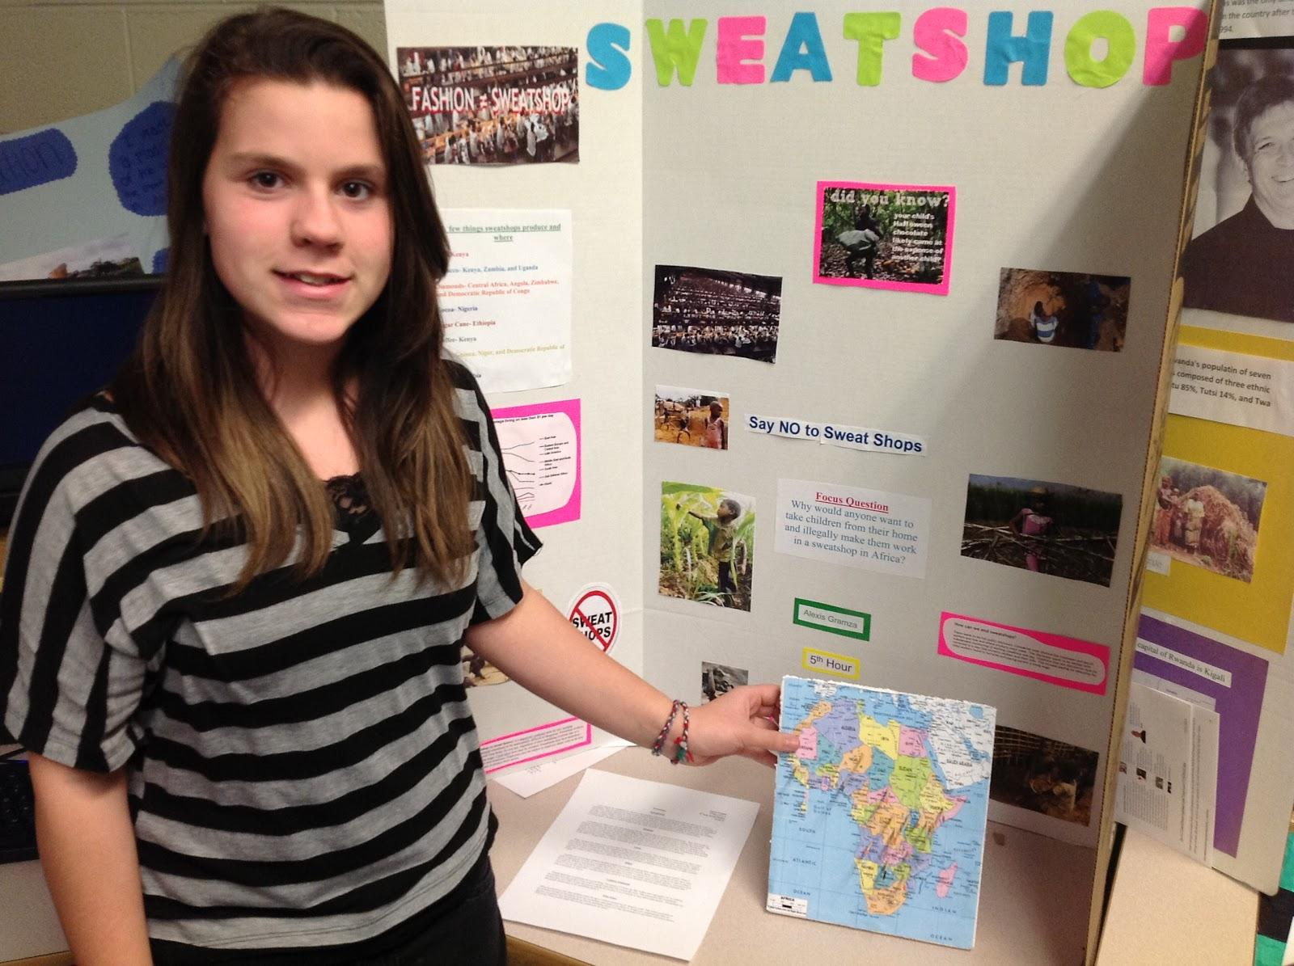

Slide 11
Creating Content
Resource
Collaborating on a shared document (Google Drive)
K & W
K = Metacognition (Think about your thinking)
W= Create Questions / Targeting my idea
Choose a Focus/Essential Question
Wikisummarizer your idea
Gathering of data/research/facts (Think like a Detective!)
Based on evidence, what is your essential question?

Slide 12
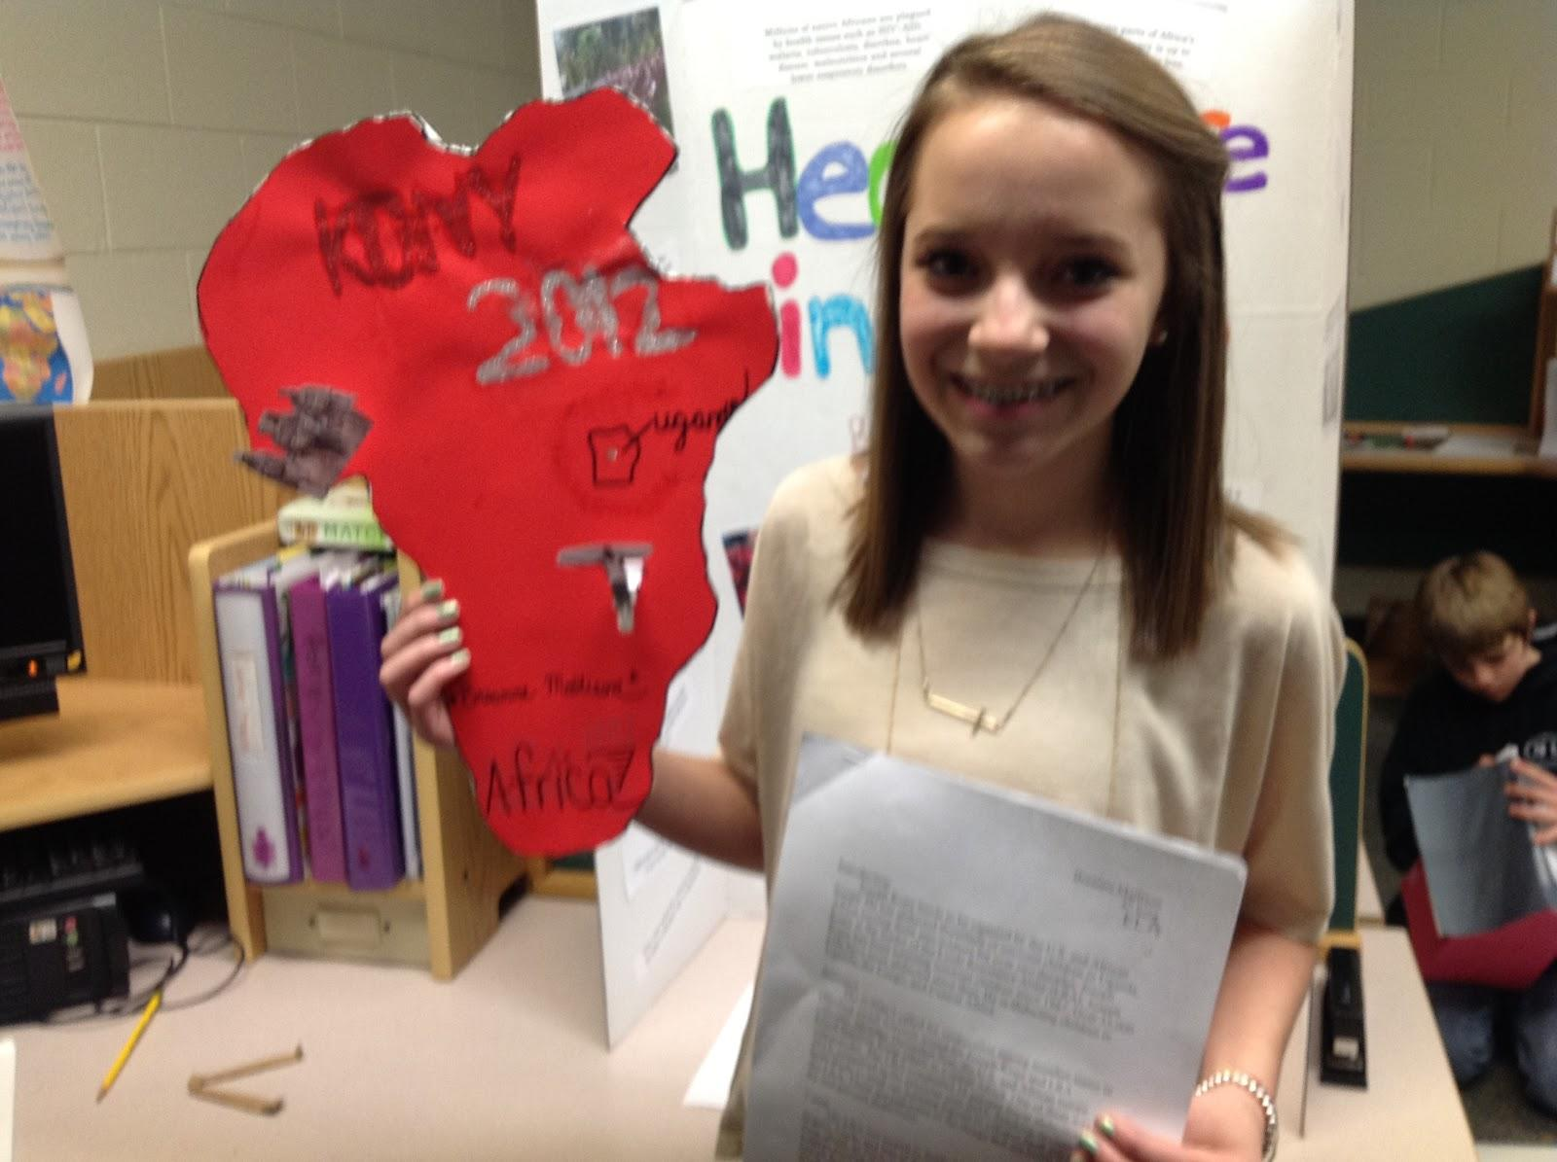

Slide 13
Creating Content
Resource
Collaborating on a shared document (Google Drive)
K & W
K = Metacognition (Think about your thinking)
W= Create Questions / Targeting my idea
Choose a Focus/Essential Question
Wikisummarizer your idea
Gathering of data/research/facts (Think like a Detective!)
Based on evidence, what is your essential question?

Slide 14
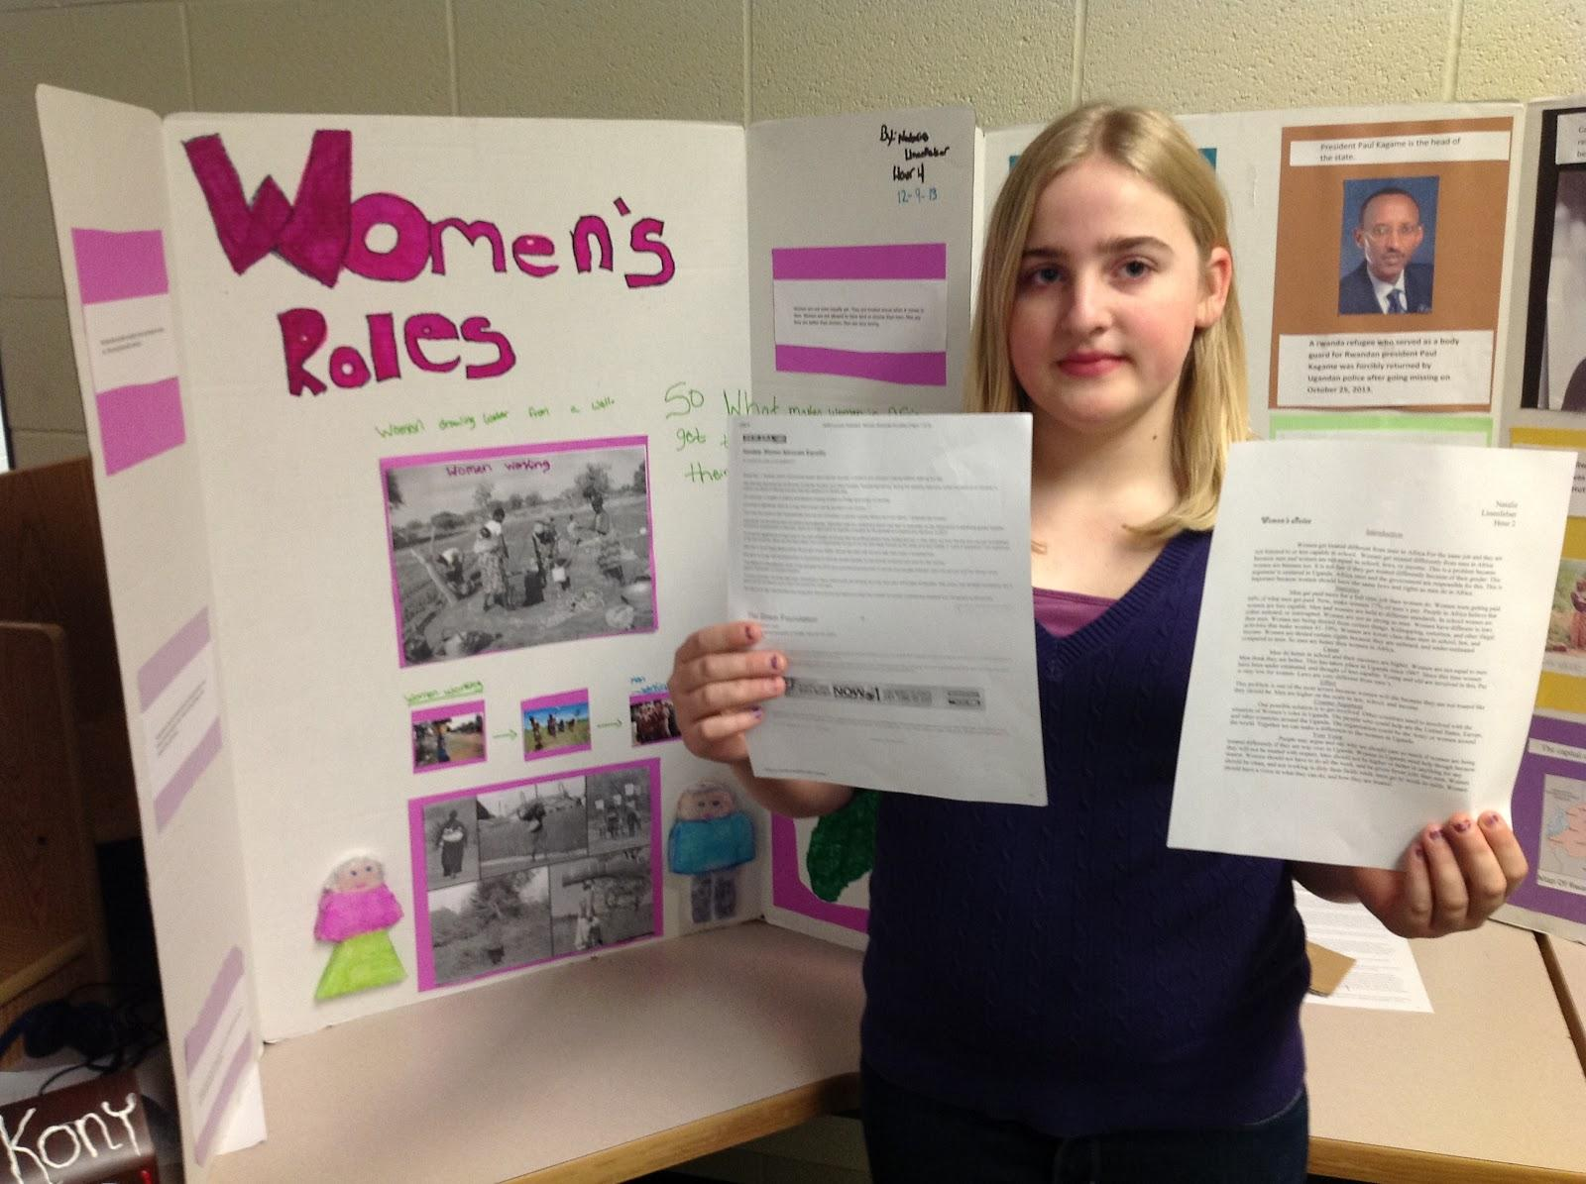

Slide 15
Creating Content
Resource
Collaborating on a shared document (Google Drive)
K & W
K = Metacognition (Think about your thinking)
W= Create Questions / Targeting my idea
Choose a Focus/Essential Question
Wikisummarizer your idea
Gathering of data/research/facts (Think like a Detective!)
Based on evidence, what is your essential question?

Slide 16
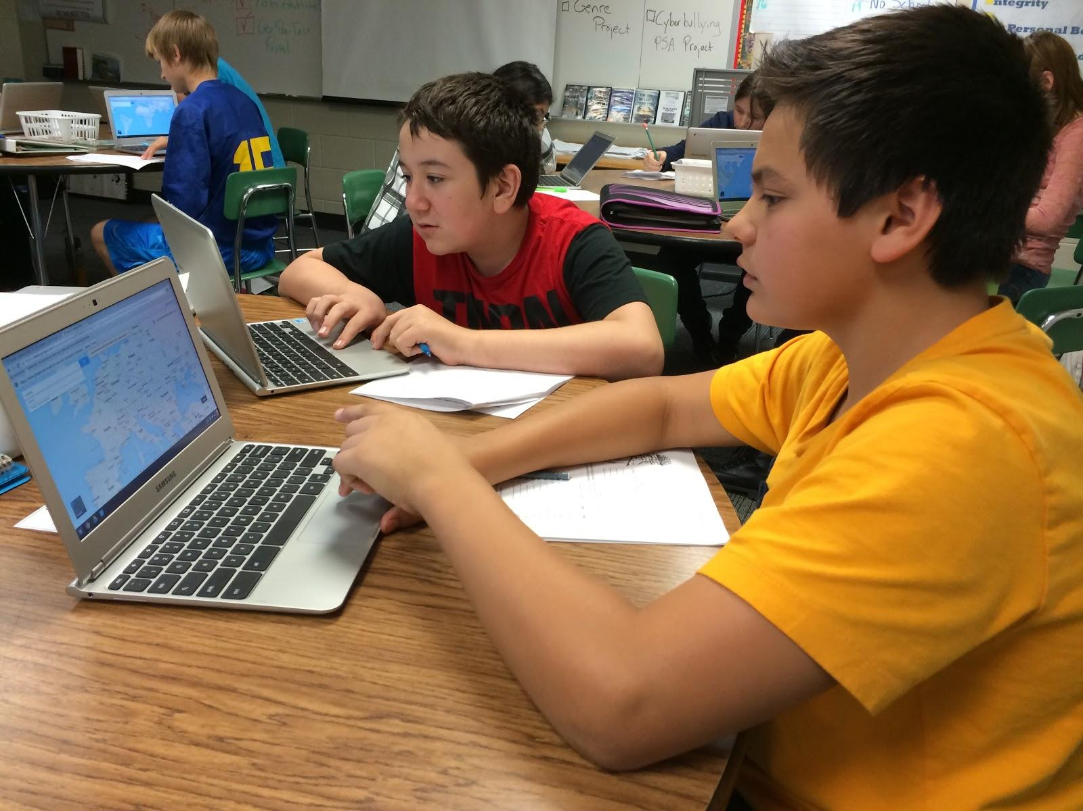
Student Example

Slide 17
Voice & Choice . . .

